Slide 1
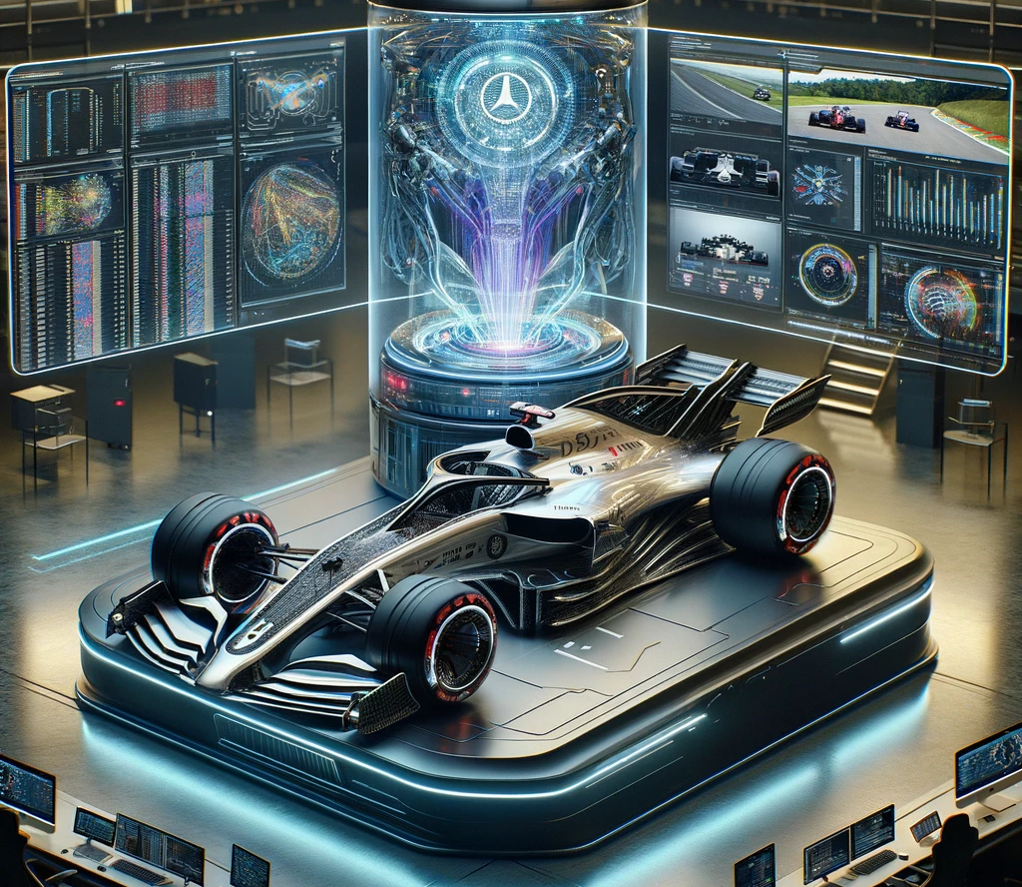

F1 Grand Prix Race Win Predictor – Sprint 2

Slide 3
Processing Steps

Slide 4
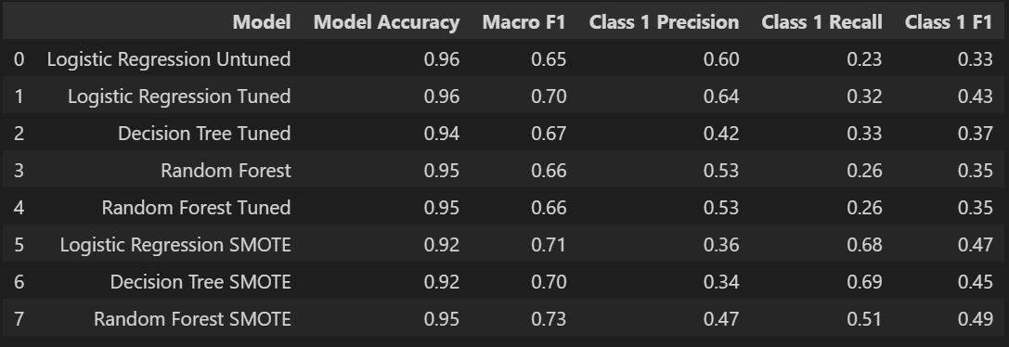
Model performance F1
Benchmark : Predict each row will not win and you will be 95% accurate.

Slide 5
Model performance F1 on 1 (race win)

Slide 6
How much money would we have made 2023?

Slide 7
Let me take you back to 2021…

Slide 8

Thanks for your time & Happy Women’s Day

